Slide 1

Reporting and Analyzing Receivables and Investments
7
Chapter
UAA – ACCT 201 Principles of Financial Accounting Dr. Fred Barbee

Slide 2
Day #1
IS FUN!
ACCOUNTING
ACCT 201 ACCT 201 ACCT 201

Slide 3
Chapter 7 - Day 1 - Agenda
Topic | LO | Read | HW
Accounts Receivable | C1, P1, P2 | 290-301 | QS2, 3; E2, 3, 4; P1A
Notes Receivable (Introduction) | C2, P3, P4 | 301-304 | QS4, 5; E6
HW #5: P6-4A Due Today

Slide 4

Accounts Receivable . . .
Accounts Receivable are . . .
  Short-term, liquid assets that arise from credit sales to customers.
  Are usually converted to cash within 10 to 60 days.

Slide 5
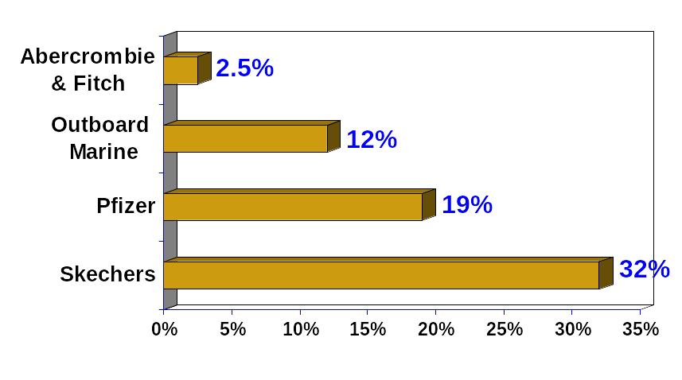
Accounts Receivable for Selected Companies
Exh.
7.1
$11.4 million
$104.9 million
$3,864 million
$46.8 million
As a percentage of total assets

Slide 6
Accounts Receivable . . .
There are three primary problems associated with Receivables . . .
  Recognition
  Valuation
  Disposition

Slide 7

1
Issue
ACCT 201 ACCT 201 ACCT 201
Recognition

Slide 8

Sales on Credit
On July 16, TechCom sells $950 of merchandise on credit to CompStore.
Now, let’s post the Account Receivable
to CompStore’s individual
account in the subsidiary ledger.

Slide 9

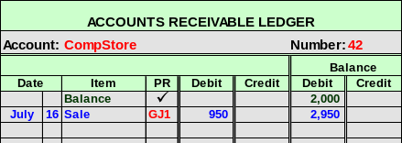
Sales on Credit
Now, let’s post to the General Ledger
Accounts Receivable control account

Slide 10

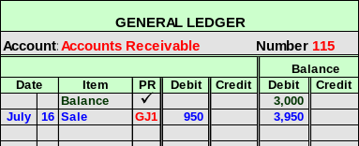
Sales on Credit

Slide 11

Sales on Credit
On July 16, TechCom receives $720 from RDA Electronics for a prior credit sale.
Now, let’s post the entry
to RDA’s individual
account in the subsidiary ledger.

Slide 12

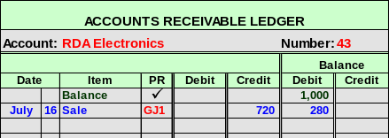
Sales on Credit
Now, let’s post to the General Ledger
Accounts Receivable control account

Slide 13

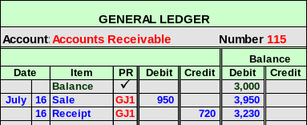
Sales on Credit

Slide 14
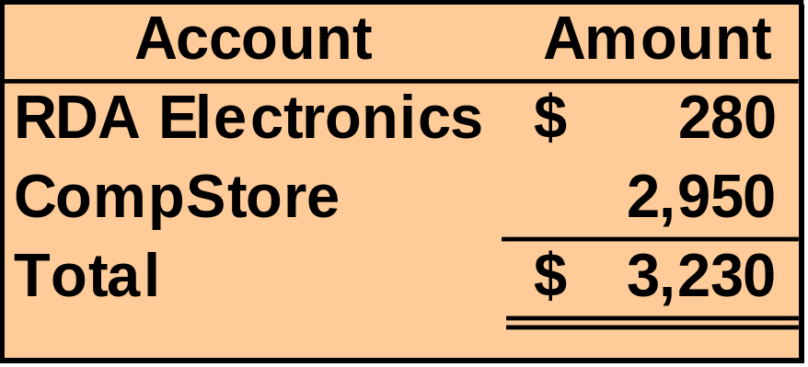
Schedule of Accounts Receivable
A Schedule of Accounts Receivable lists the balances of individual customers’ accounts receivable.

Slide 15


Credit Card Sales
Advantages of allowing
customers to use credit cards:
Customers’ credit is evaluated by the credit card issuer.
Sales increase by providing purchase options to the customer.
The risks of extending credit are transferred to the credit card issuer.
Cash collections are speeded up.

Slide 16
Credit Card Sales
With bank credit cards, the seller
deposits the credit card sales receipt
in the bank just like it deposits a
customer’s check.
The bank increases the balance in the
company’s checking account.
The company usually pays a fee of 2%
to 5% for the service.

Slide 17

Credit Card Sales
TechCom has a bank credit card sale of $100 to a customer. The bank charges a processing fee
of 4%. The cash is received immediately.

Slide 18
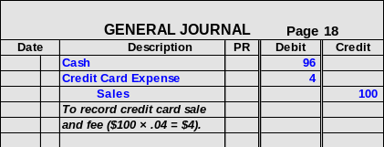
Credit Card Sales
Prepare the journal entry to record the sale.

Slide 19
2
Issue
ACCT 201 ACCT 201 ACCT 201
Valuation

Slide 20

Uncollectible Accounts
Uncollectible accounts have effects on two financial statements . . .
  Balance sheet, and
  Income statement

Slide 21
Let’s . . .
ACCT 201 ACCT 201 ACCT 201
At the Income Statement

Slide 22
Income Statement
Objective:
  Derive a fair measurement of net income
Method:
  An adequate amount for bad debts expense should be matched against (deducted from) the sales revenue.

Slide 23
Let’s . . .
ACCT 201 ACCT 201 ACCT 201
At the Balance Sheet

Slide 24
Balance Sheet
Objective:
  Properly value accounts receivable
Method:
  Adjust Accounts Receivable to reflect the amounts expected to be collected.

Slide 25
Accounting For Uncollectible Accounts
There are two methods of accounting for Uncollectible Accounts . . .
  The direct write-off method; and
  The allowance method.

Slide 26
1
Method
ACCT 201 ACCT 201 ACCT 201
Direct Write-Off

Slide 27
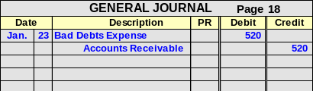
Direct Write-Off Method
On January 23, TechCom determines it cannot collect $520 from Jack Kent, a credit customer.
ACCT 201 ACCT 201 ACCT 201

Slide 28
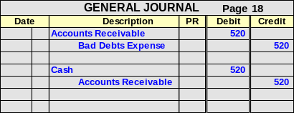
Direct Write-Off Method
If Jack Kent later pays the $520, the previous entry is simply reversed and the cash collection is recorded.
ACCT 201 ACCT 201 ACCT 201

Slide 29
2
Method
ACCT 201 ACCT 201 ACCT 201
Allowance Method

Slide 30
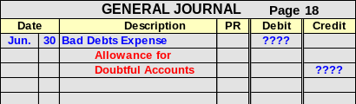
Allowance Method
At the end of each period, estimate total bad debts expected to be realized from that period’s sales.
This is a contra-asset account.
ACCT 201 ACCT 201 ACCT 201

Slide 31
Estimating Bad Debts Expense
Percent of Sales Method
Accounts Receivable Methods
  Percent of Accounts Receivable
  Aging of Accounts Receivable Method

Slide 32
ACCT 201 ACCT 201 ACCT 201
An Overview Using T-Accounts

Slide 33




Based on:
Allowance for Doubtful Accounts
Sales
xxx
Estimate the amount of uncollectible accounts.
or
xxx
Accts Rec
xxx
Bad Debts Expense
Then Credit the Allowance account
xxx
And Debit the Expense Account
Matching

Slide 34
1
Method
ACCT 201 ACCT 201 ACCT 201
Percent of Sales Method

Slide 35

Percent of Sales Method
Bad debts expense is computed as follows:

Slide 36

Percent of Sales Method
MusicLand has credit sales of $400,000 in 2002.
MusicLand estimates 6% of credit sales are uncollectible.
What is Bad Debts Expense for 2002?

Slide 37
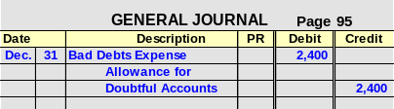
Allowance Method
 | $400,000
X | 0.06%
= | $2,400
MusicLand computes estimated Bad Debts Expense of $2,400
ACCT 201 ACCT 201 ACCT 201

Slide 38
2
Method
Percent of Accounts Receivable Method
ACCT 201 ACCT 201 ACCT 201

Slide 39
Percent of Accounts Receivable Method
Compute the estimate of the Allowance for Doubtful Accounts.
  Year-End Accounts Receivable x Bad Debt %

Slide 40

Percent of Accounts Receivable Method
Bad Debts Expense is computed as:

Slide 41
Percent of Accounts Receivable
MusicLand has $50,000 in Accounts Receivable and a $200 credit balance in Allowance for Doubtful Accounts on December 31, 2002.
Past experience suggests that 5% of receivables are uncollectible.
What is MusicLand’s Bad Debt Expense for 2002

Slide 42
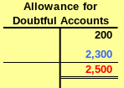

% of Accounts Receivable
Desired balance in Allowance for Doubtful Accounts.
 | $50,000
X | 0.05%
= | $2,500

Slide 43

Aging of Accounts Receivable Method
Compute a separate allowance
for each age grouping.
Each age grouping has a
different likelihood of being
uncollectible.
Year-end Accounts Receivable is
broken down into age
classifications.

Slide 44
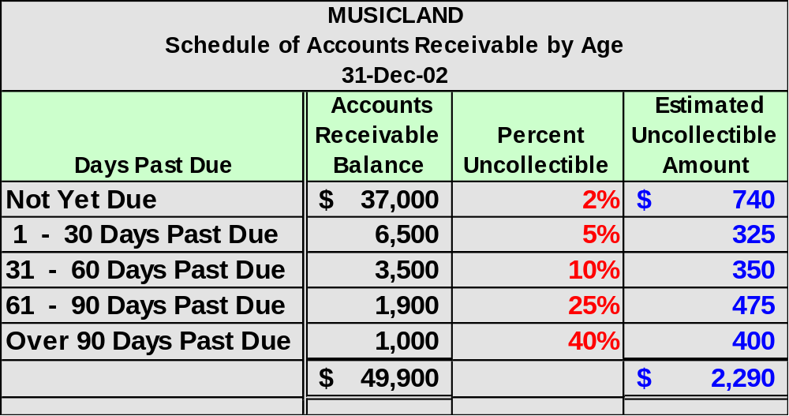
Aging of Accounts Receivable

Slide 45
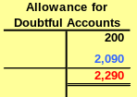

Aging of Accounts Receivable
MusicLand’s unadjusted balance in the allowance account is $200. Per the previous computation, the desired balance is $2,290.

Slide 46
3
Issue
ACCT 201 ACCT 201 ACCT 201
Disposition

Slide 47
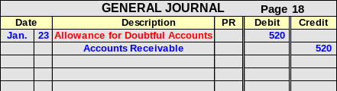
Writing Off a Bad Debt
With the allowance method, when an account is determined to be uncollectible, the debit is to Allowance for Doubtful Accounts.
TechCom determines that Jack Kent’s
$520 account is uncollectible.

Slide 48
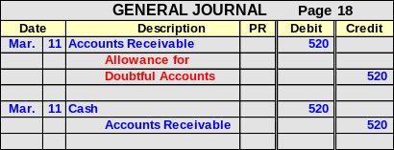
Recovery of a Bad Debt
Subsequent collections require that the original write-off entry be reversed before the cash collection is recorded.

Slide 49
Exh.
7.13
% of Sales
Emphasis on Matching
% of Receivables
Emphasis on Realizable Value
Aging of Receivables
Sales
Bad Debts Exp.
Emphasis on Realizable Value
Accts. Rec.
All. for Doubtful Accts.
Income Statement Focus
Accts. Rec.
All. for Doubtful Accts.
Balance Sheet Focus
Balance Sheet Focus

Slide 50
Notes Receivable
ACCT 201 ACCT 201 ACCT 201

Slide 51

Notes Receivable
A note is a written
promise to pay a specific amount at a specific future date.

Slide 52
Exh.
7.14
Notes Receivable
Term
$1,000.00
July 10, 2002
Payee
Ninety days
after date I promise to pay to
the order of
TechCom Company, Los Angeles, CA
One thousand and no/100 ---------------------------------
Dollars
Payable at
First National Bank of Los Angeles, CA
Maker
Value received with interest at per annum
12%
Julia Browne
No. Due
42
Oct. 8, 2002
For TechCom.
ACCT 201 ACCT 201 ACCT 201

Slide 53
Exh.
7.14
Notes Receivable
$1,000.00
July 10, 2002
Ninety days
after date I promise to pay to
the order of
Principal
TechCom Company, Los Angeles, CA
One thousand and no/100 ---------------------------------
Dollars
Payable at
First National Bank of Los Angeles, CA
Interest Rate
Value received with interest at per annum
12%
Julia Browne
No. Due
42
Oct. 8, 2002
For TechCom.
Due Date
ACCT 201 ACCT 201 ACCT 201

Slide 54
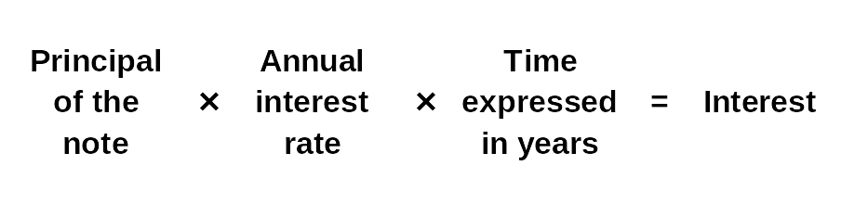
Exh.
7.16
Interest Computation
Even for maturities less than 1 year, the rate is annualized.
If the note is expressed in days, base a year on 360 days.
ACCT 201 ACCT 201 ACCT 201

Slide 55
Interest Computation
On March 1, 2002, Smithson, Inc. purchased a copier for $9,000 from Machines, Inc. Smithson gave Machines, Inc. a 12% note due in 90 days in payment for the copier.
How much interest will be paid to Machines, Inc. in 90 days?

Slide 56
Exh.
7.16
Interest Computation
$9,000 | X | 12% | X | 90/360 | = | $270
ACCT 201 ACCT 201 ACCT 201

Slide 57
End-of-Period Adjustments
When a note receivable is outstanding at the end of an accounting period, the company must prepare an adjusting entry to accrue interest income.

Slide 58
Converting Receivables to Cash Before Maturity
Sell the accounts receivable to a financing company or bank (called factoring).
Borrow money and pledge the receivables as security for the loan (called pledging).

Slide 59
Full-Disclosure Principle
Requires financial statements and notes to report all relevant information about the operations and financial position of a company.
  Potential tax assessments
  Guarantee of debts of others
  Outstanding lawsuits

